Slide 1
MINERVANS
THE EDUCATION SYSTEM YOU CAN TRUST
ABHISHEK S KURUP
KAVERI MENOKI
SANDRA ELIZABETH SABU
TEENA VINCENT

Slide 2
CONTENTS:
Introduction
Output
Conclusion

Slide 3
INTRODUCTION:
In today's education field we have to get acquainted with the modern tech.
Our team developed a website which provides DAILY TECH NEWS.
Also provides a YOUTUBE PLAYLIST and ROADMAP of different domains in technology.

Slide 4
DIFFERENT PAGES IN OUR WEBSITE
1. DASHBOARD
Provides basic information about the technology
2.TECH NEWS
Provides day-to-day tech news
3.ROADMAPS
Provide roadmaps of different domains

Slide 5
DIFFERENT PAGES IN OUR WEBSITE
4. PLAYLISTS
Playlist of best tutors of YouTube for each domains.
5. FAVOURITES
Customisable playlist

Slide 6
OUTPUT

Slide 7
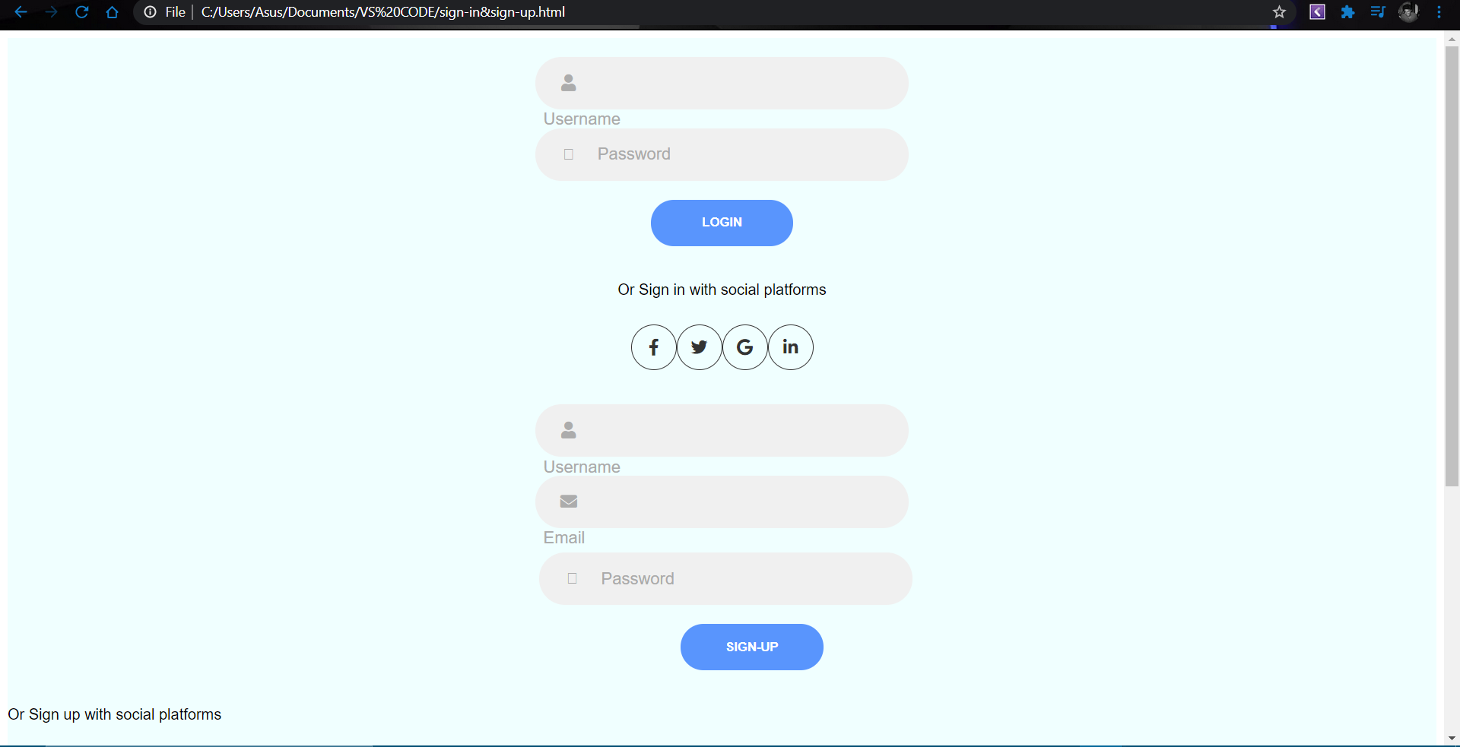
Sign in & Sign up

Slide 8
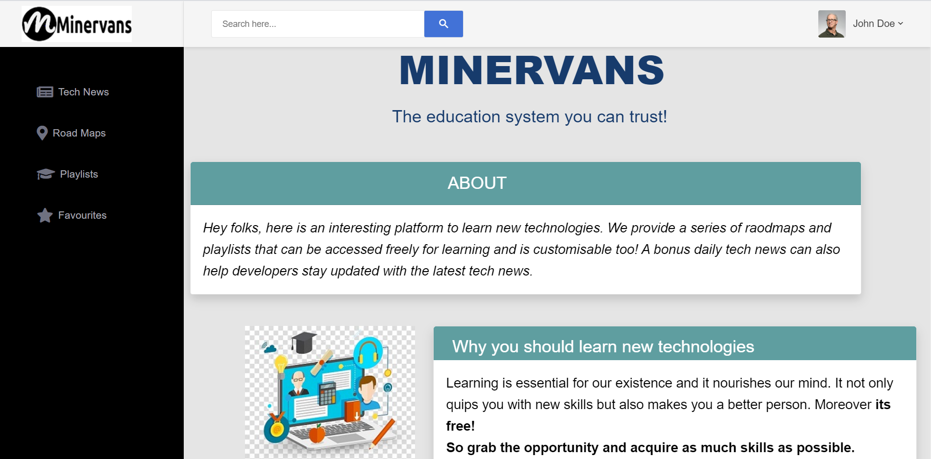
Dashboard: The user logins in and reaches the home page first

Slide 9
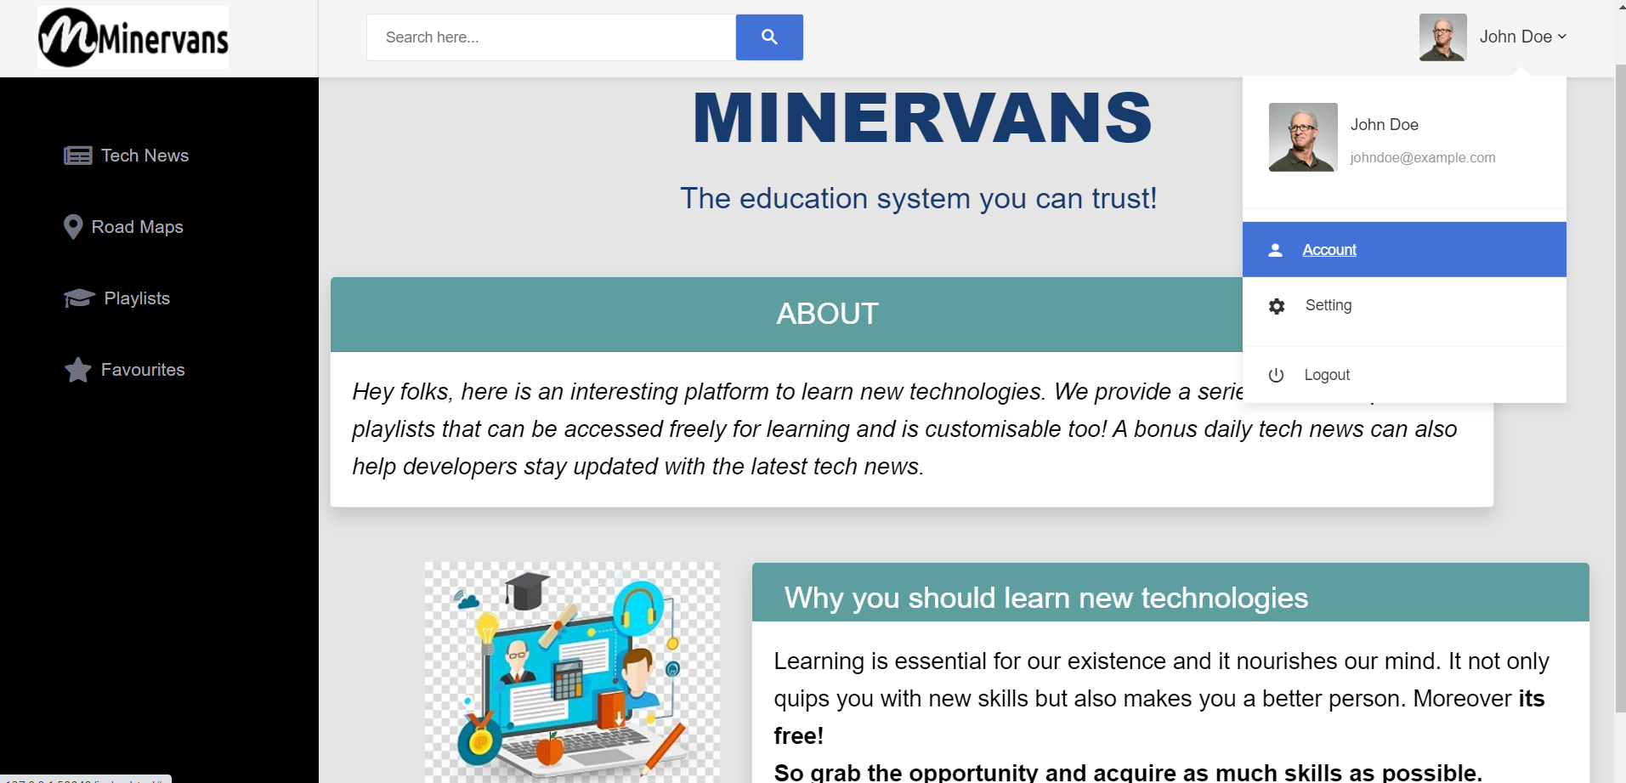
Dashboard: User’s account, setting, and logout options

Slide 10
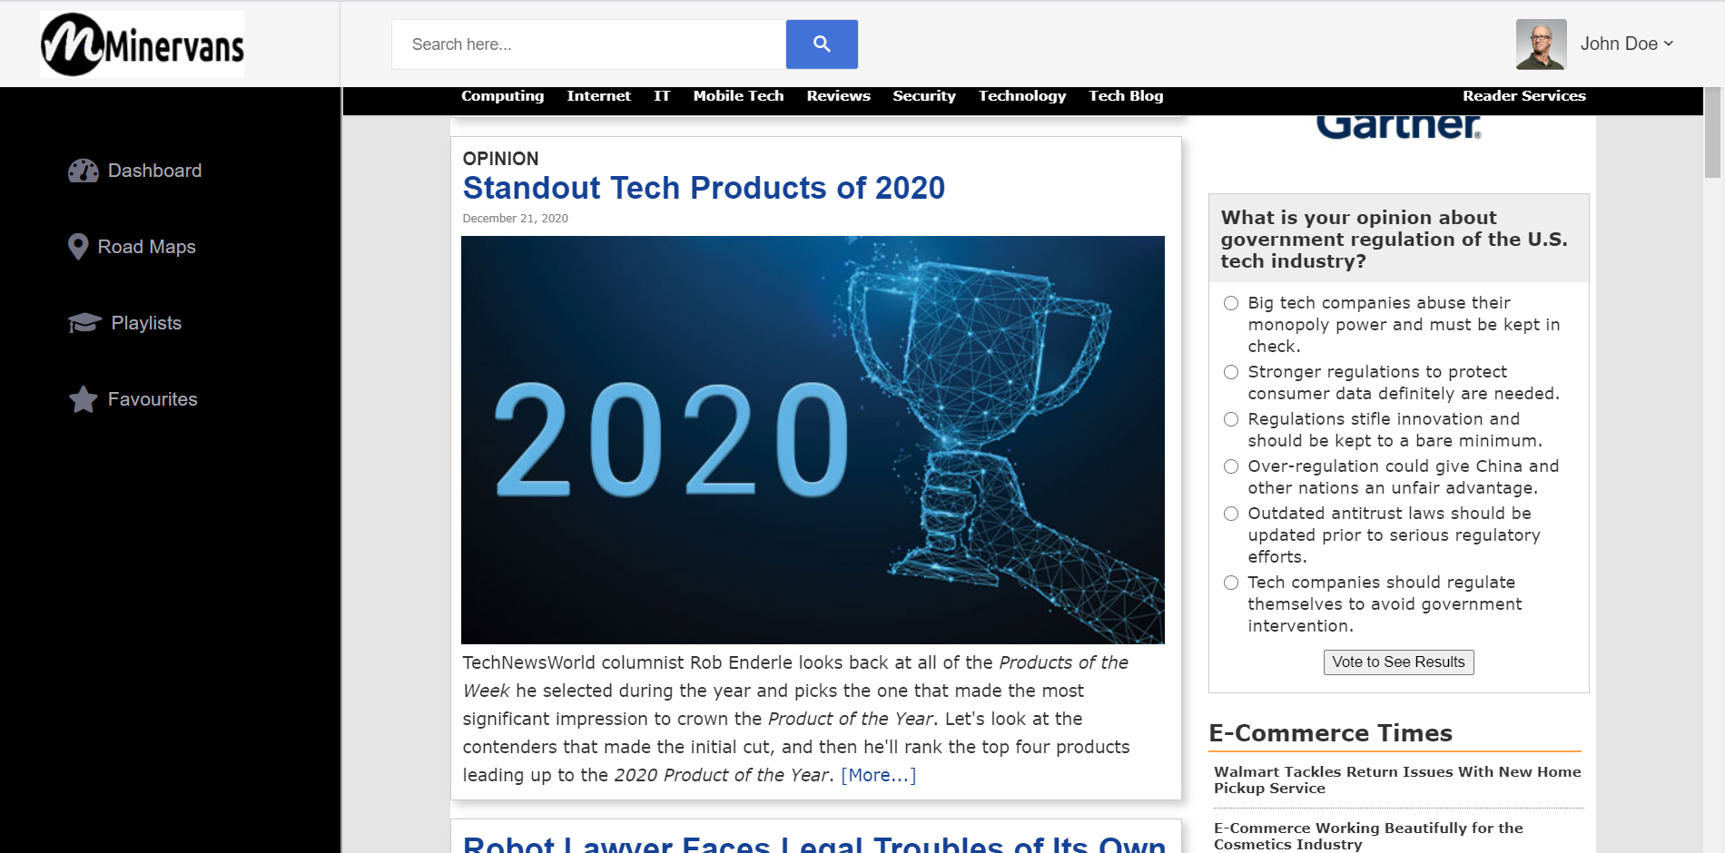
Tech News

Slide 11
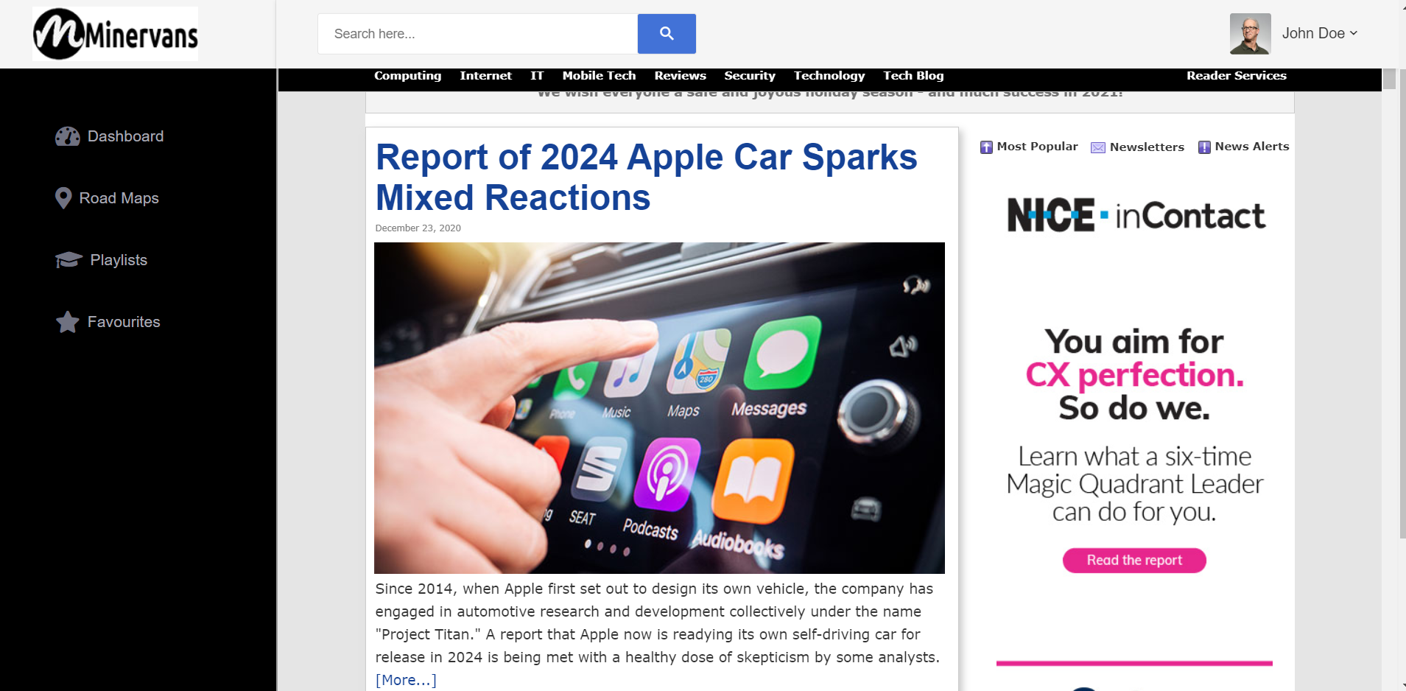
Tech News: Get Tech news updates

Slide 12
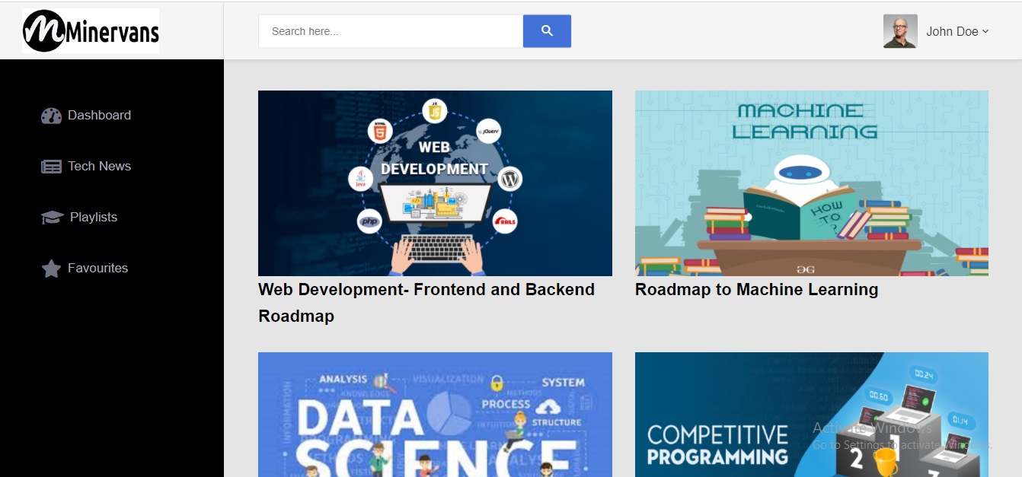
Road Maps of different Domains

Slide 13
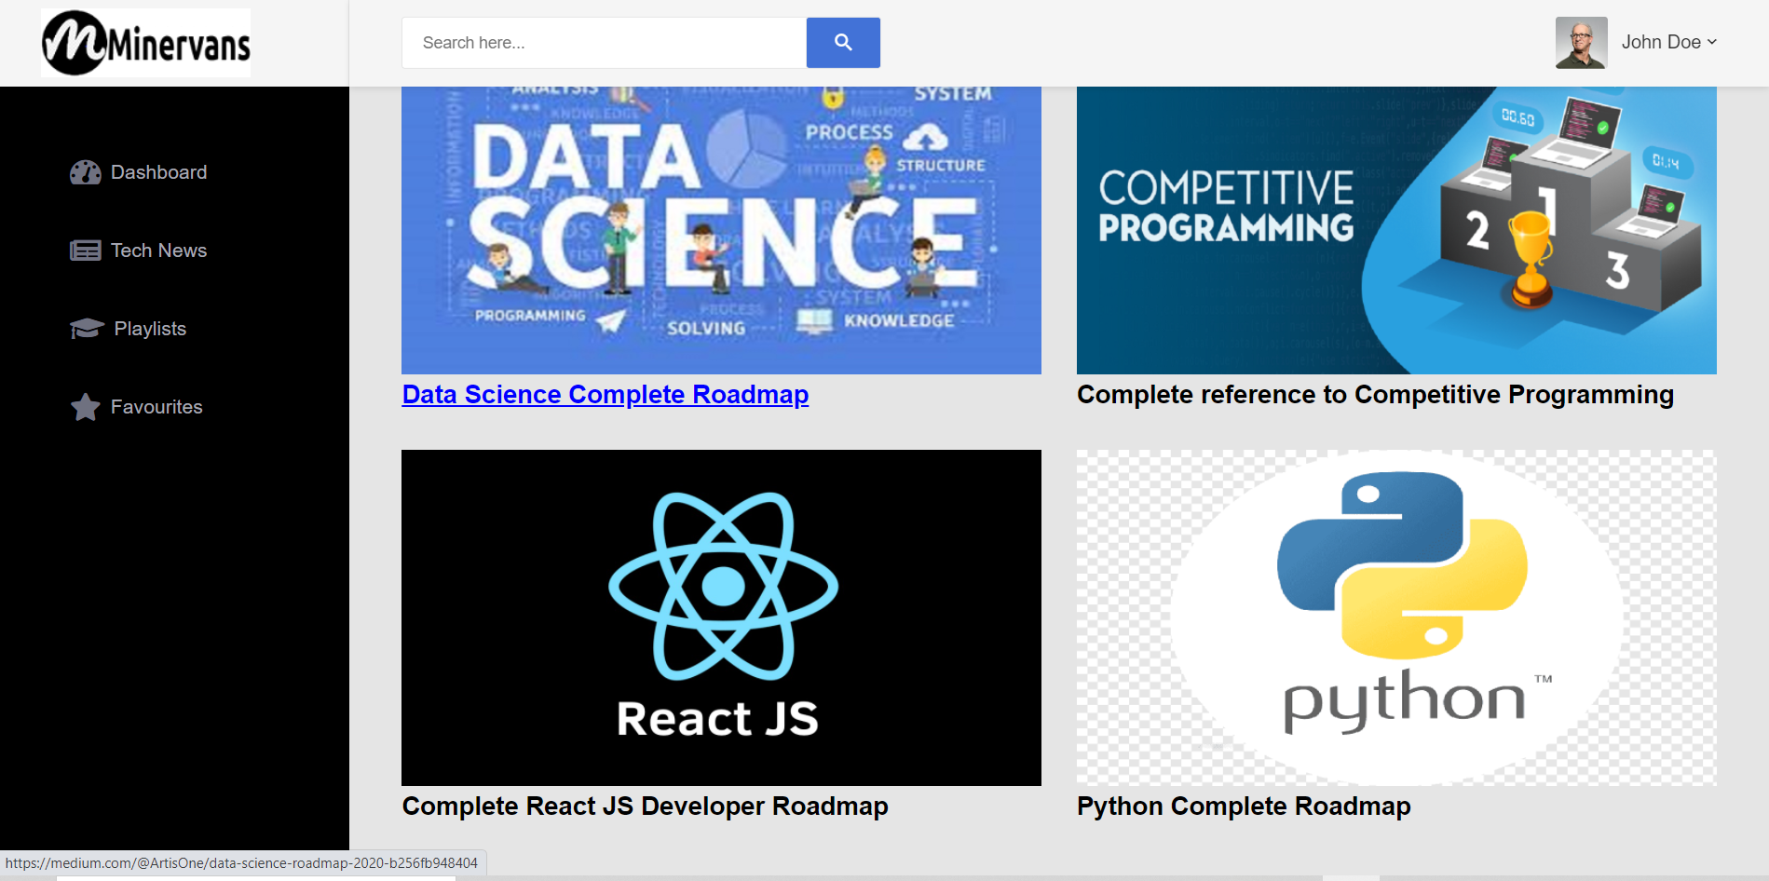
Road Maps: Choosing a particular roadmap

Slide 14
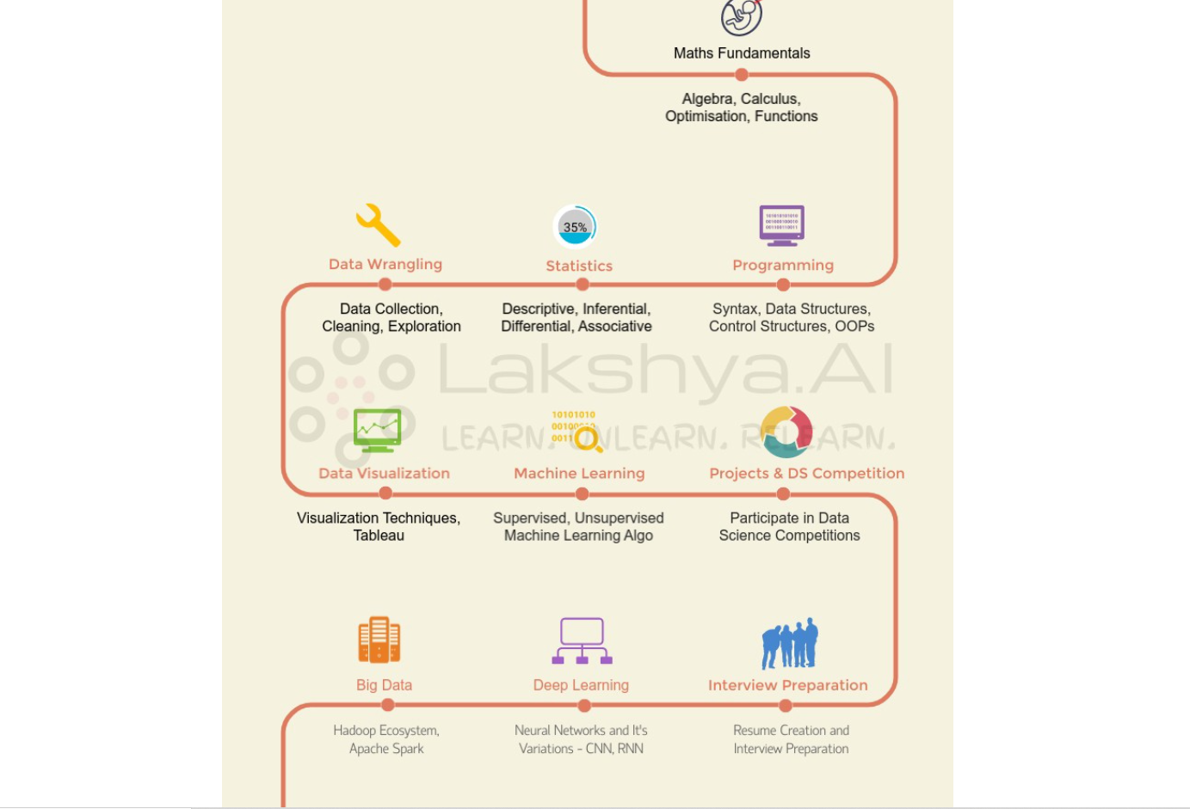
Road Map of the chosen domain

Slide 15
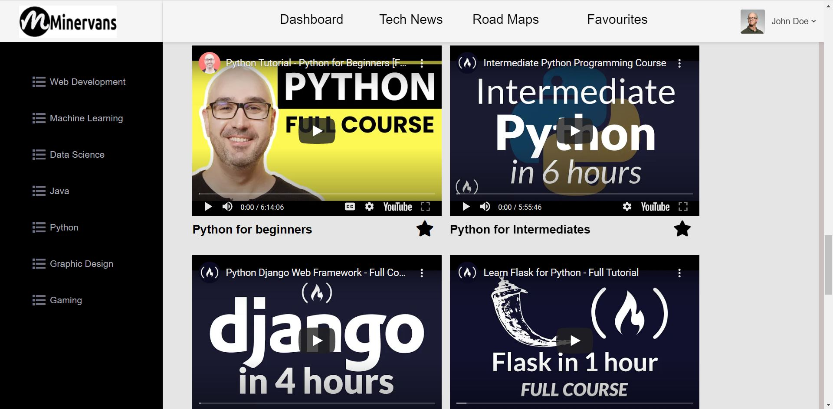
Playlists: Collection of youtube playlists of many domains

Slide 16
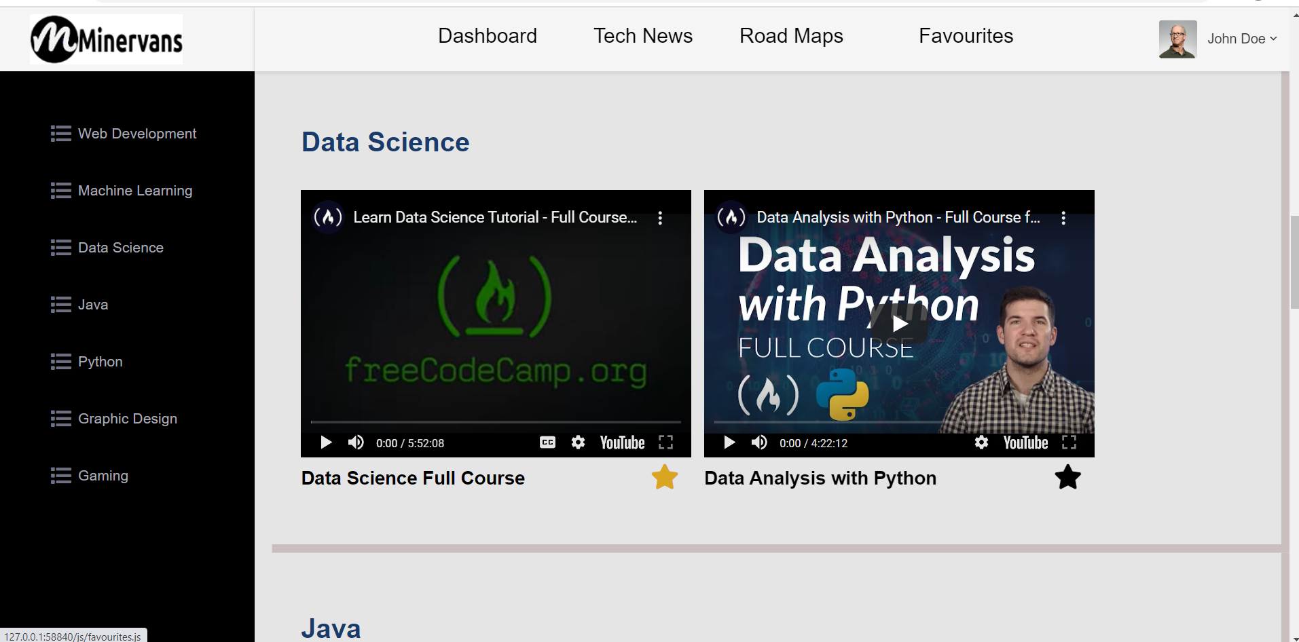
Playlists: Adding a playlist to Favourites (customising playlist)

Slide 17
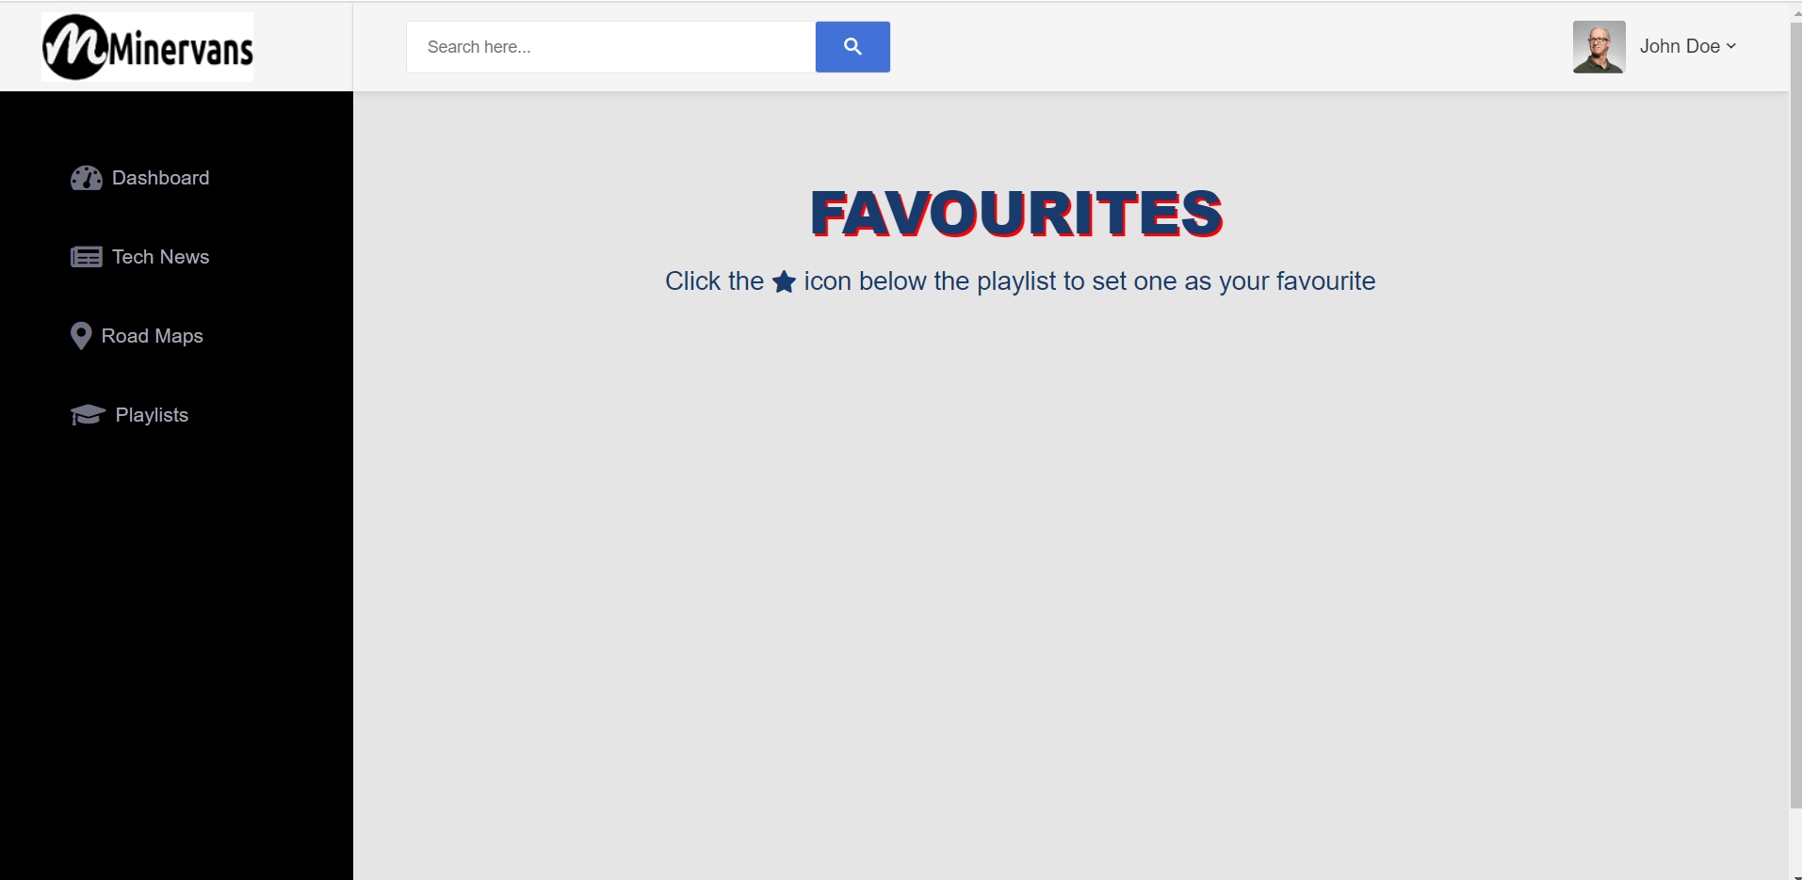
Favourites: Custom favourites page of each user

Slide 18
FUTURE EXPANSION
A Quiz Section to measure our Knowledge.
Providing Badges for Skills learned

Slide 19
CONCLUSION
In this current covid scenario,online education is the only possible way to gain knowledge.
This project mainly enhances knowledge on technology.
We provide people the roadmaps and youtube playlists of different domain.
The Roadmaps provide an idea on the steps to learn a new tech , the resources required. The youtube playlist provide the platform to learn these domains and develop projects in it.
We should also be aware about the day-to-day happenings in the world of technology so we are also providing a tech-news page where people can browse day to day tech news.
We aim in helping more people in the easiest way possible.

Slide 20
THANK YOU

